Slide 1

& HPAI H5N1 analysis
Isabella Monne
FAO/OIE and National Reference Laboratory for avian influenza & Newcastle disease Istituto Zooprofilattico Sperimentale delle Venezie (IZSVe) Legnaro (Padova), Italy
imonne@izsvenezie.it

Slide 2

Upload your sequences
Perform BLAST research, alignment and phylogenetic analyses
Enter and search in GISAID database
Create your workset
Set the information you want to visualize for every sample in the database

Slide 3
EpiFlu Database training activities:
How to create a workset
How to insert sequences in it from GISAID or by uploading
How to retrieve sequences from the GISAID database
How to blast a sequence
How to align sequences
How to download sequences
How to create preliminary phylogenetic trees
How to perform simple analyses, as understanding to which clade our sequence belongs

Slide 4
EpiFlu DB & HP H5N1 analysis: dataset presentation

Slide 5
Highly pathogenic H5N1 avian influenza viruses: clade designation
Avian HP H5N1 viruses continue to spread, continue to infect animals and humans, and continue to evolve and diversify.
An international consultative group of scientists (named as WHO/OIE/FAO H5N1 Evolution Working Group ) was convened by the World Health Organization (WHO), the World Organisation for Animal Health (OIE) and the Food and Agriculture Organization (FAO) to develop a standard clade nomenclature system based upon the evolution of this H5 HA

Slide 6
Unified nomenclature system for the highly pathogenic H5N1 avian influenza viruses
Clades are defined as meeting the following three specific clade definition criteria developed by the WHO/OIE/FAO H5N1 Evolution Working Group:
sharing of a common (clade-defining) node in the phylogenetic tree;
monophyletic grouping with a bootstrap value of ≥60 at the clade-defining node (after 1000 neighbor-joining bootstrap replicates);
average percentage pairwise nucleotide distances between and within clades of >1.5% and <1.5%, respectively.
New sublineages (potential H5N1 clades) periodically emerge. Once these sublineages meet the same three specific clade definition criteria as the initial clades (listed above), they are designated as separate clades

Slide 7
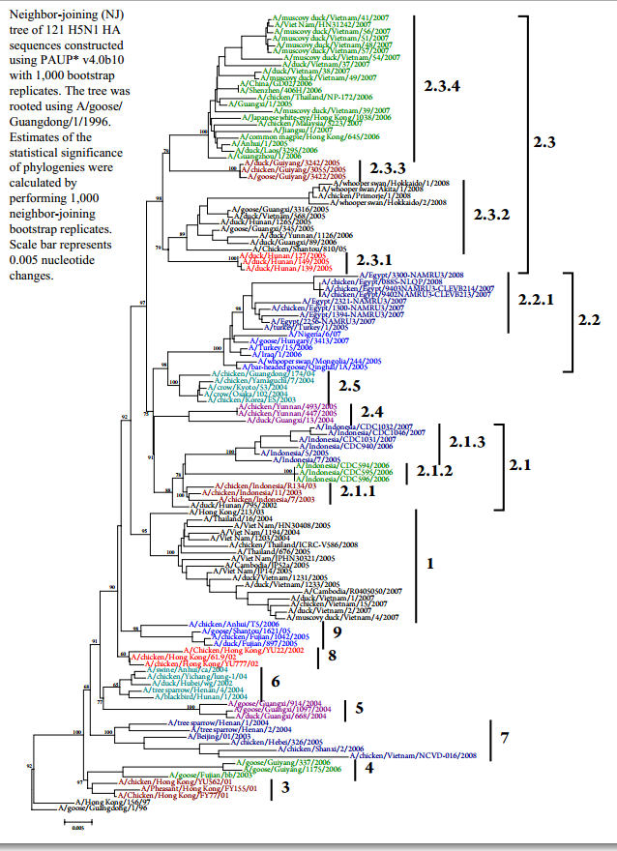

Slide 8
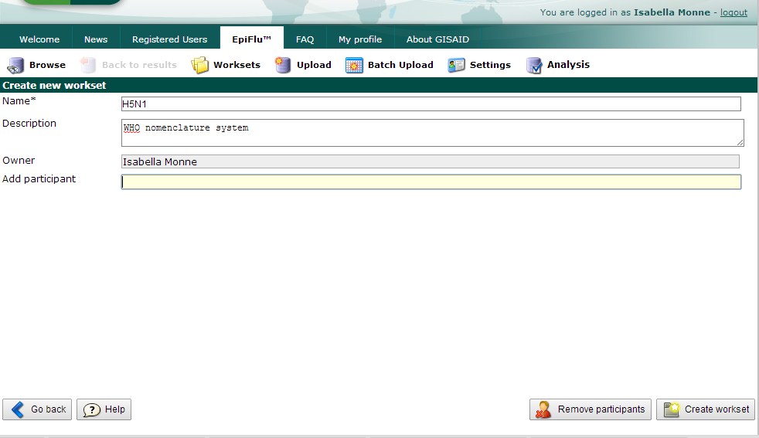

Excercise:
Clade identification of two selected H5N1 HA sequences available in GISAID:
One from Egypt collected in 2013
One from Russia collected in 2008
I) Create a workset:

Slide 9
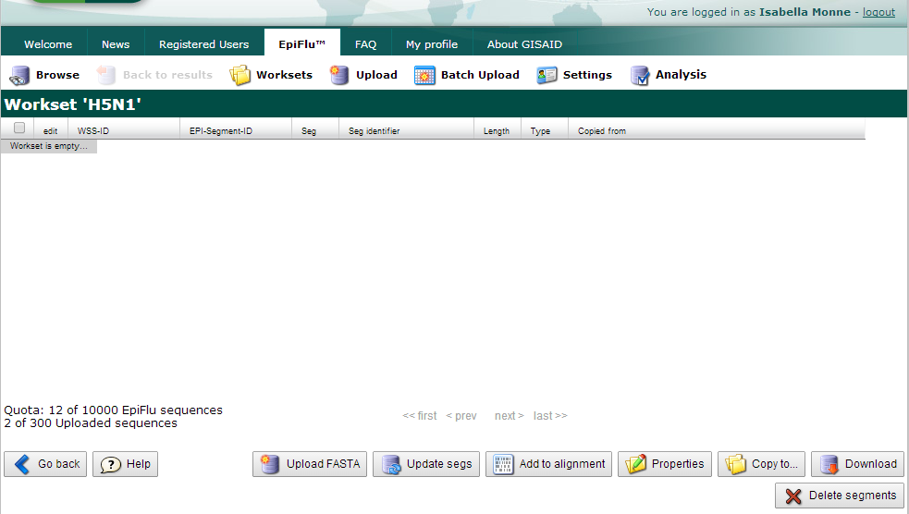
II) Upload your sequences into the workset

Slide 10
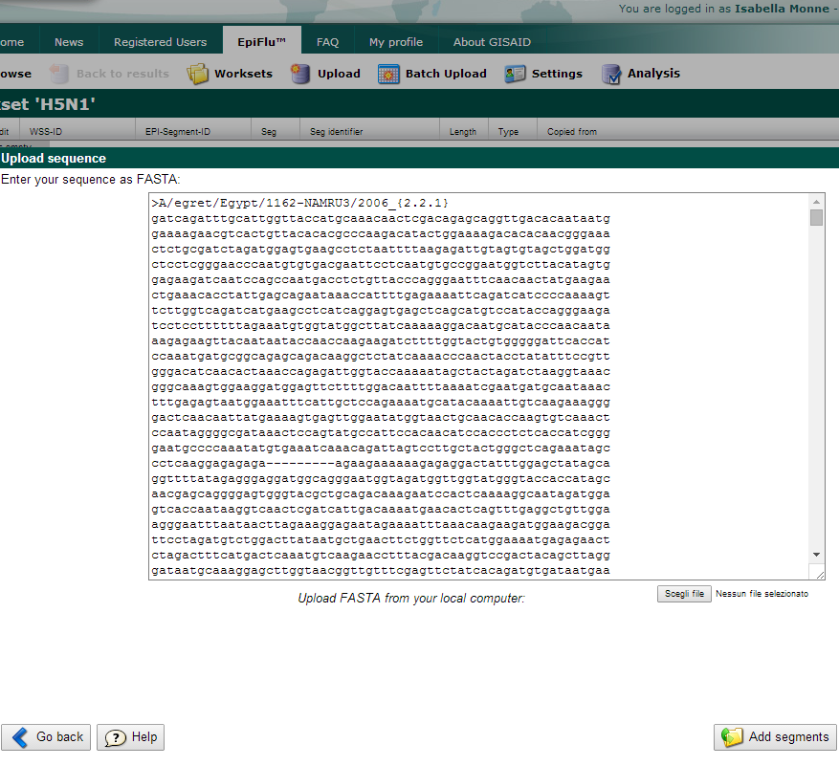


Select the file “H5N1_nomenclature.txt” containing the reference sequences for the WHO nomenclature system

Slide 11
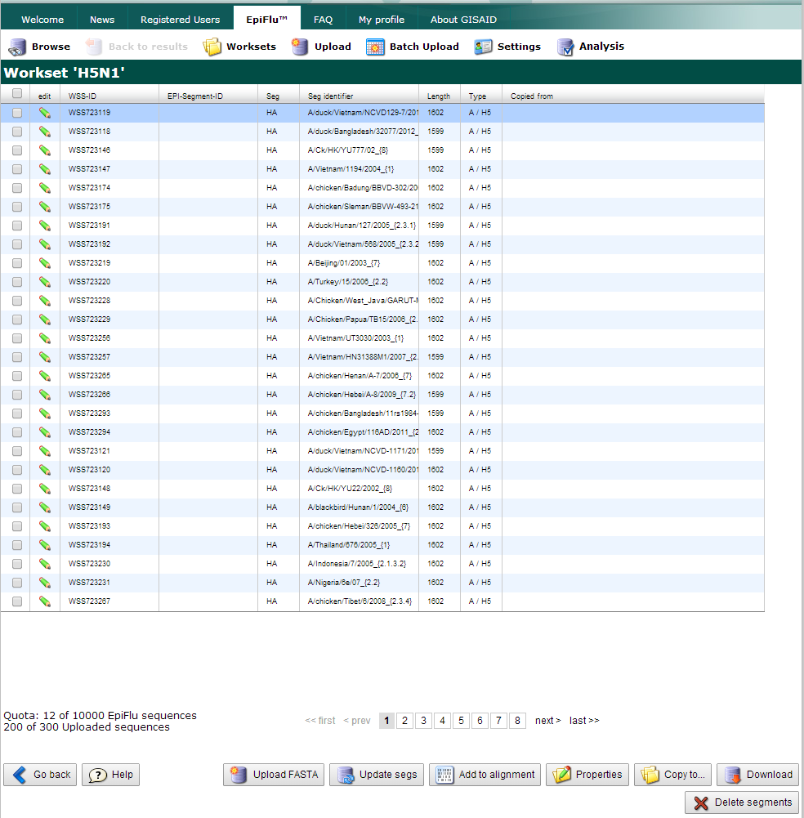
Now you have your sequences loaded into your H5N1 workset

Slide 12
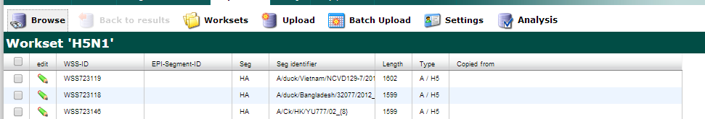
III) Add sequences from the GISAID database in your workset
Go to Browse section
Search for all the H5N1 HA sequences collected in Egypt between 2013 and 2014 and download one or more

Slide 13
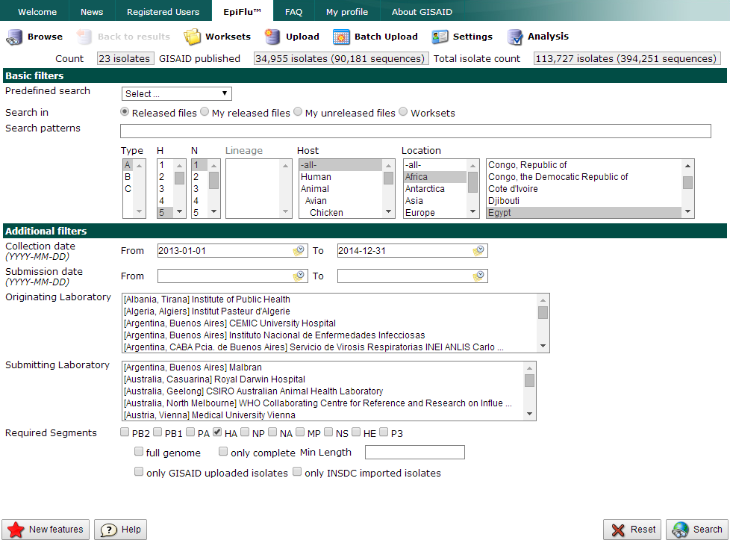

Slide 14
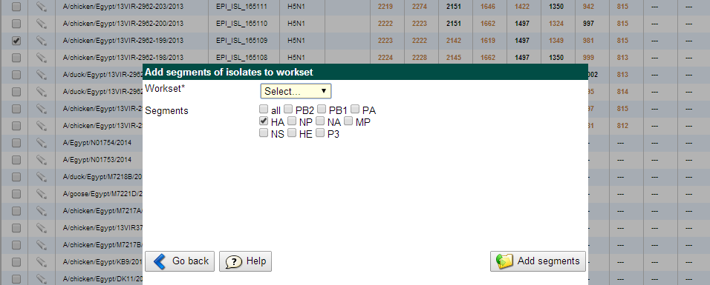
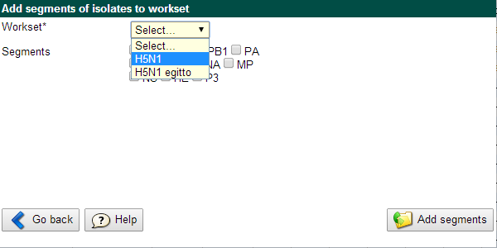
Select one or more sequences of your interest and add them to your previously created workset

Slide 15
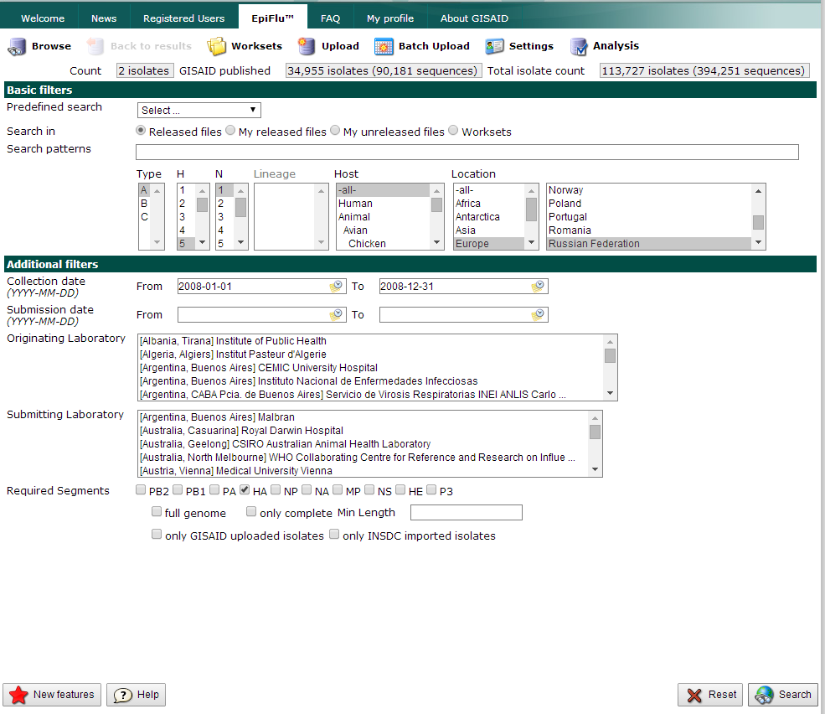
Now download Russian H5N1 HA sequences collected in 2008

Slide 16
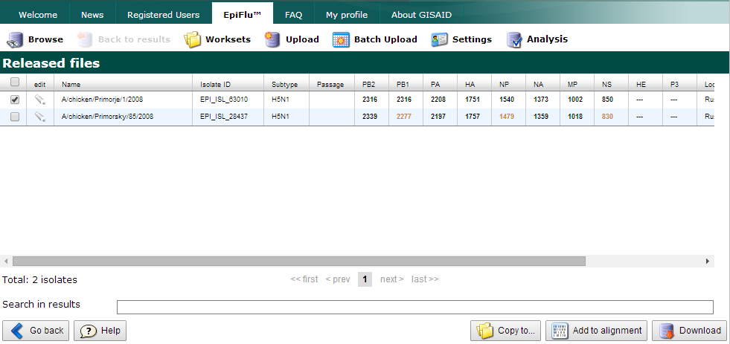
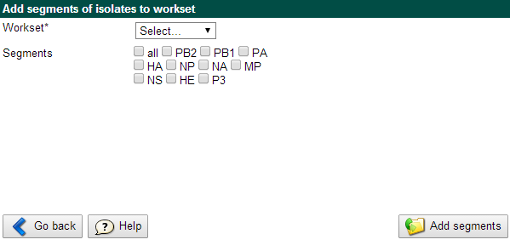

Slide 17
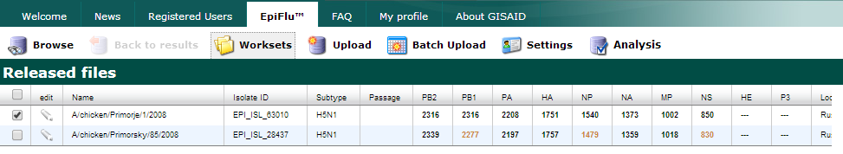
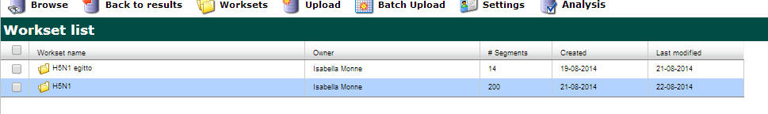
Open your workset to visualize all the sequences

Slide 18
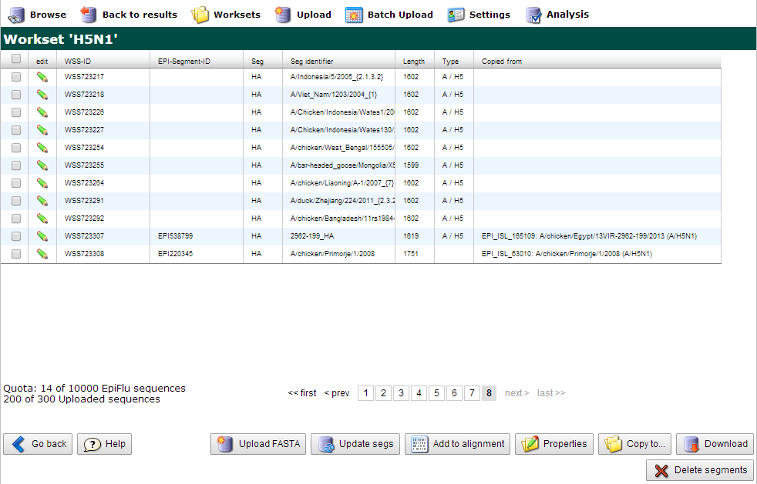
The last two sequences are the sequences under study

Slide 19
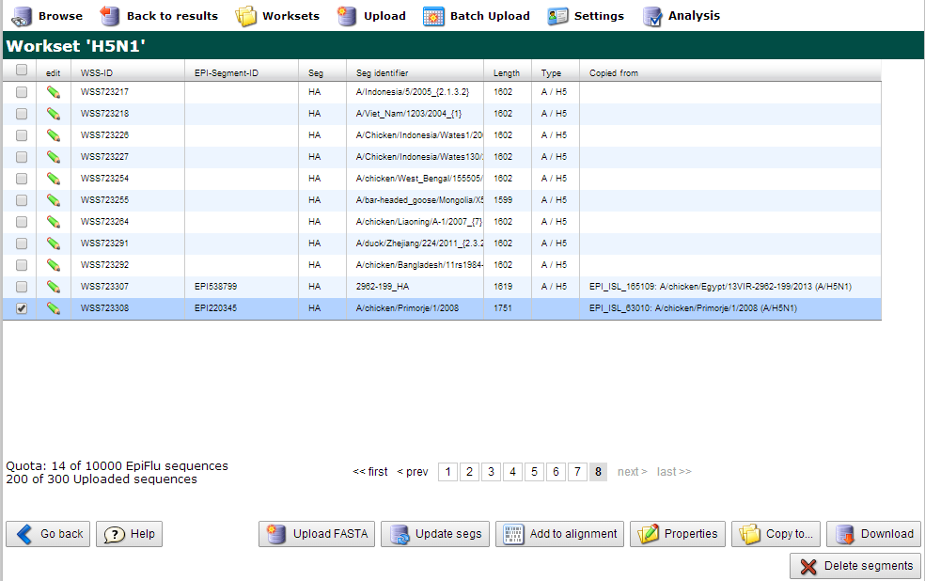
IV) Blast the two sequences under study
Open the first sequence by clicking on it

Slide 20
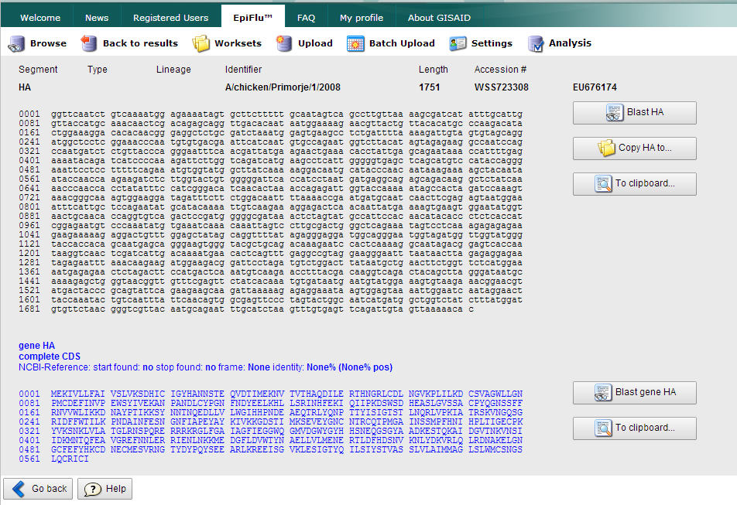
In the opened window click on :
Blast HA
To Blast the nucleotide sequence
Blast gene HA
to blast the aminoacidic sequence

Slide 21
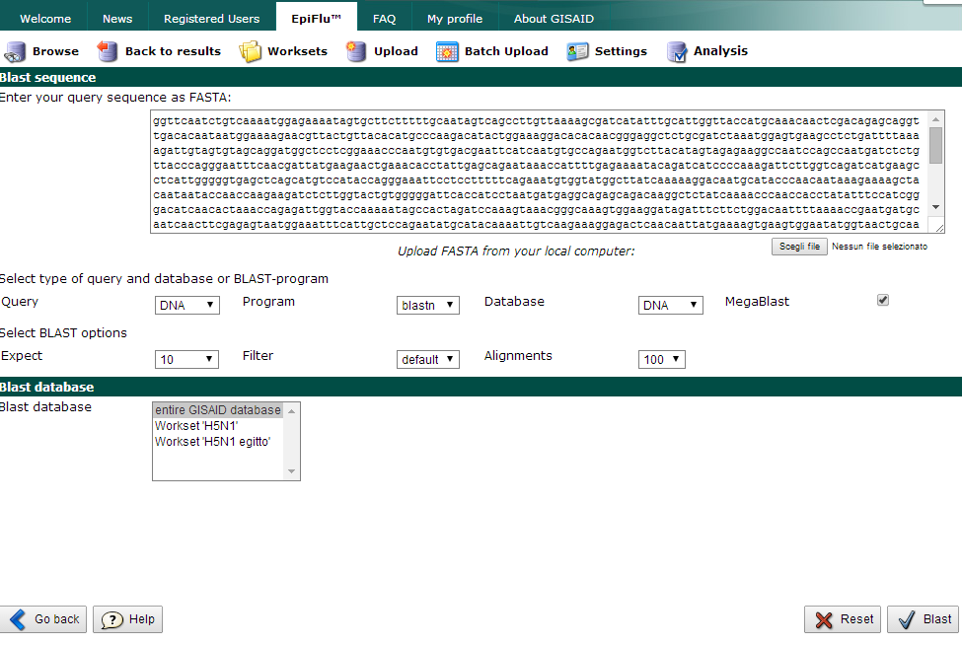
You will enter in the Blast page
You can choose the database in which to search

Slide 22
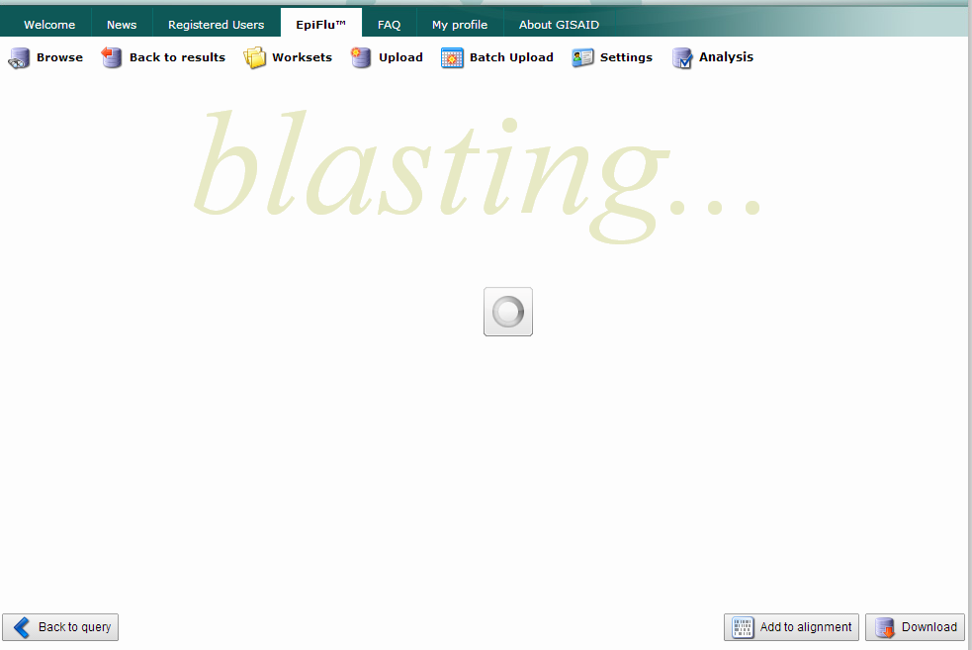

Slide 23
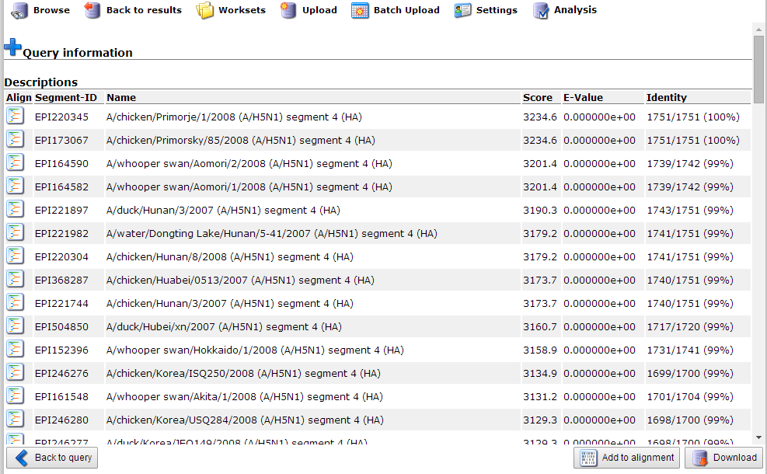
Blast results
You can add them to alignment

Slide 24
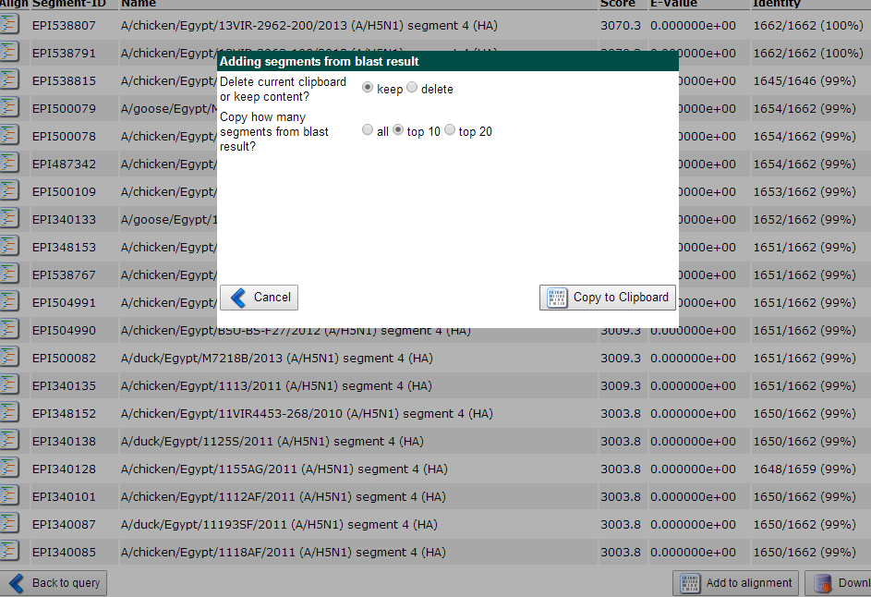
Select the first 10 results and add them to the alignment;
Do the same for the second sequence under study

Slide 25
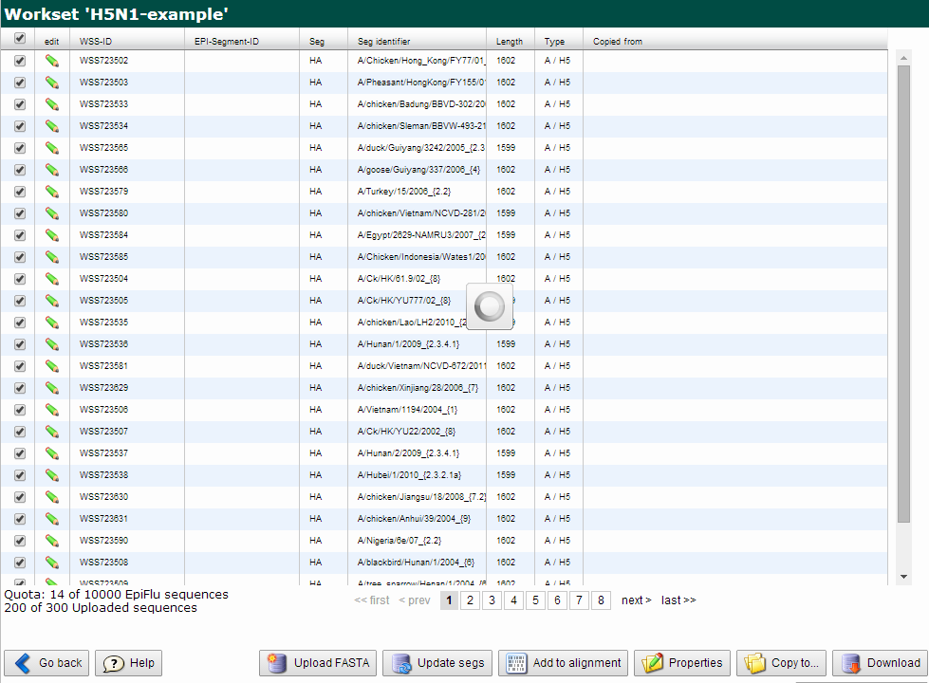
You now have 20 sequences in your alignment
Add all the sequences of your workset to the alignment:
1) enter in the workset
2) Select all the sequences
3) Add them to the alignment

Slide 26
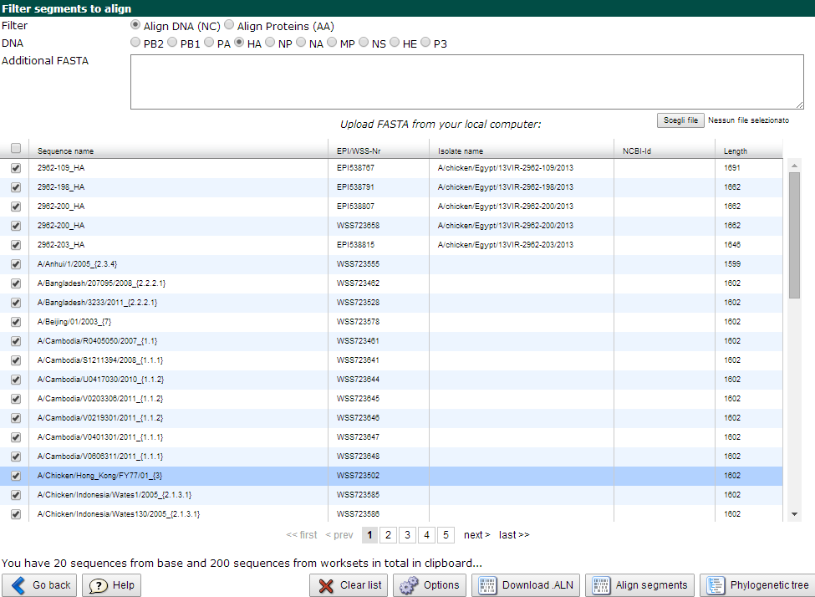
Now you have 220 sequences in your alignment:
20 from the blast search
200 from your workset
Before doing the alignment set the options

Slide 27
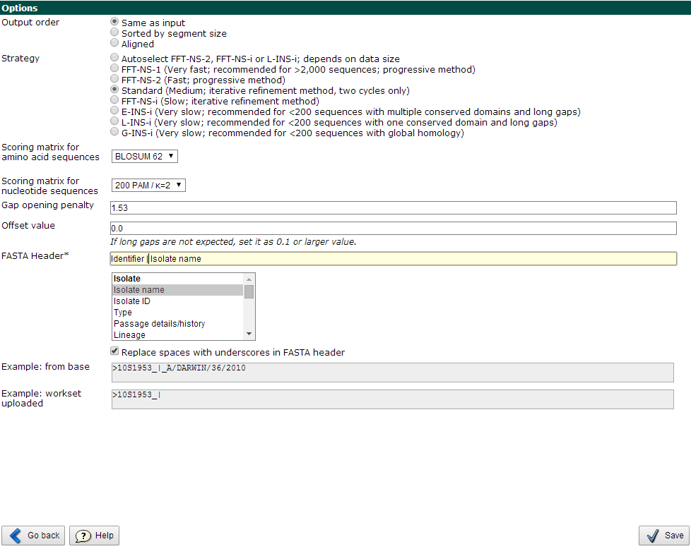
This set what you are going to see in the tree leafs

Slide 28
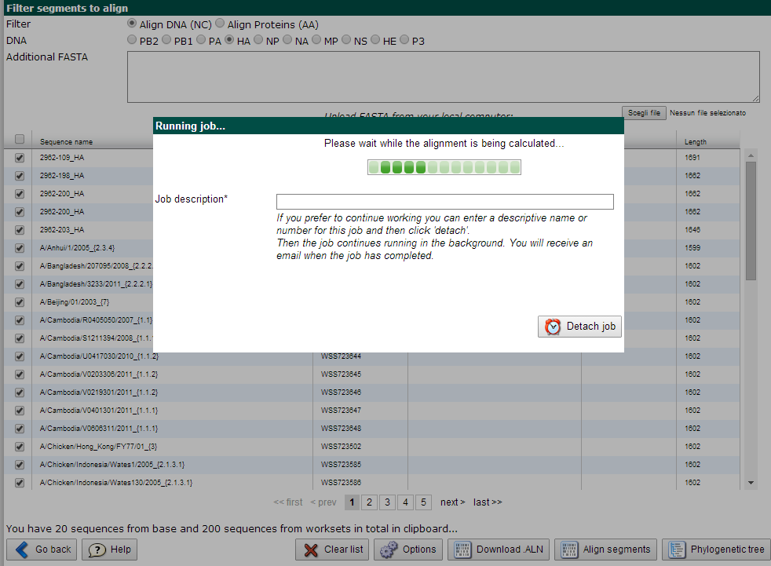
Let’s do the alignment!

Slide 29
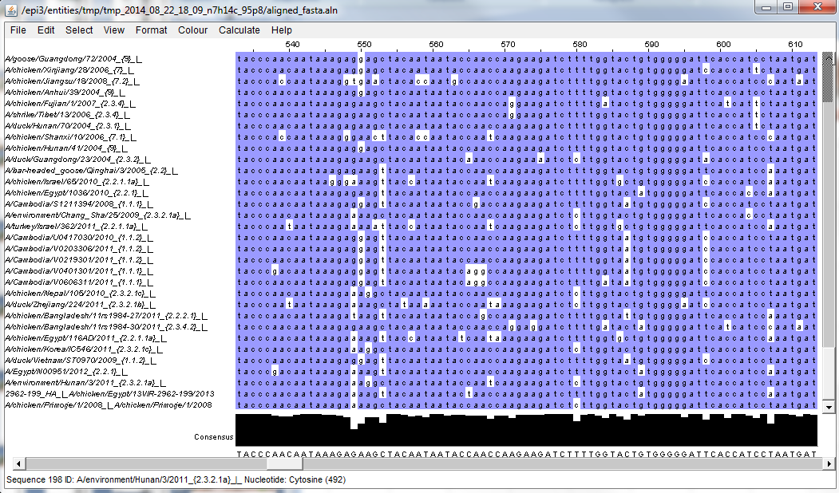
This is the output of the alignment

Slide 30
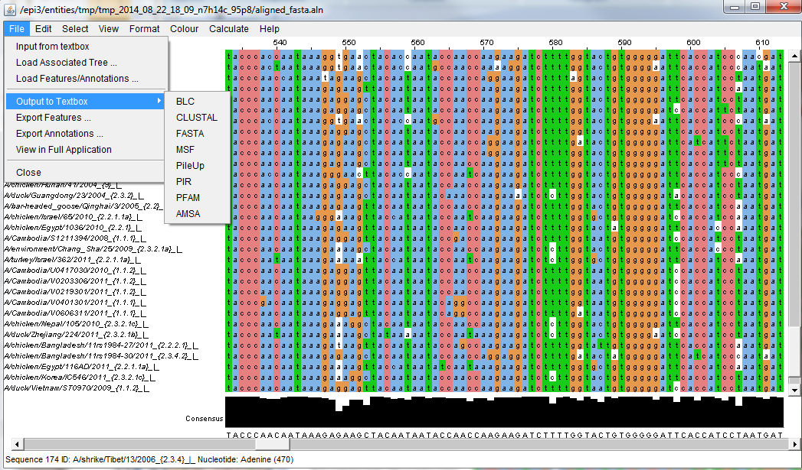
Exporting the alignment in different formats

Slide 31
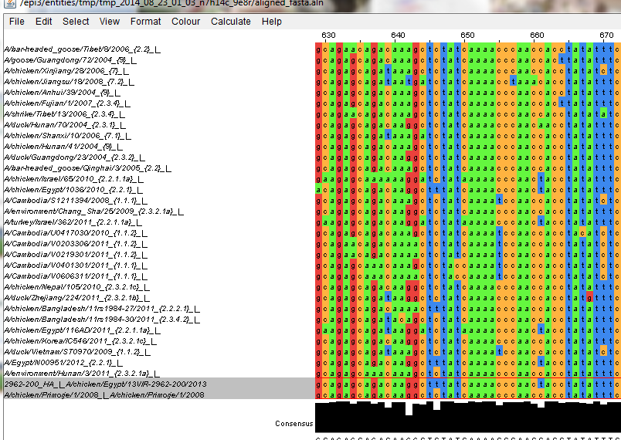
These are the sequences under study

Slide 32
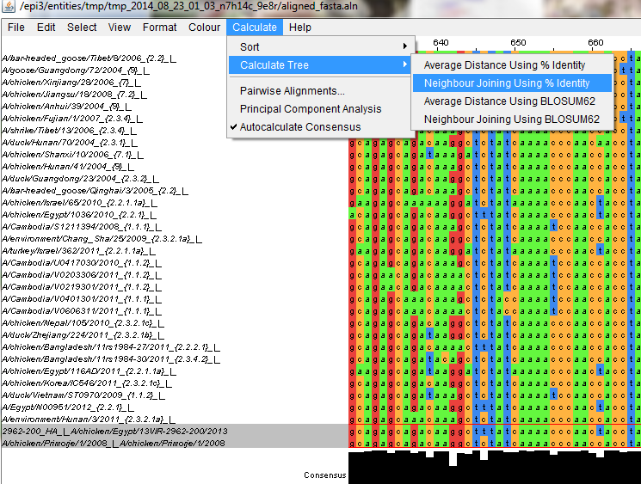
Creating a preliminary phylogenetic tree using
Neighbour Joining method

Slide 33
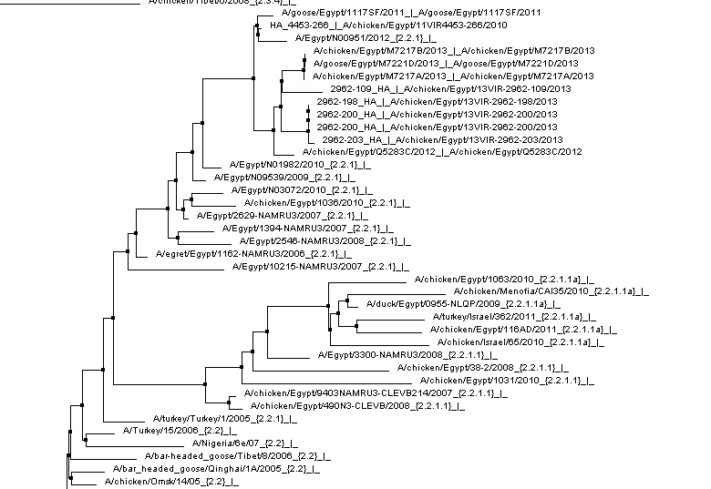
Identify the belonging clade of the studied samples
The Egyptian sample belong to clade 2.2.1

Slide 34
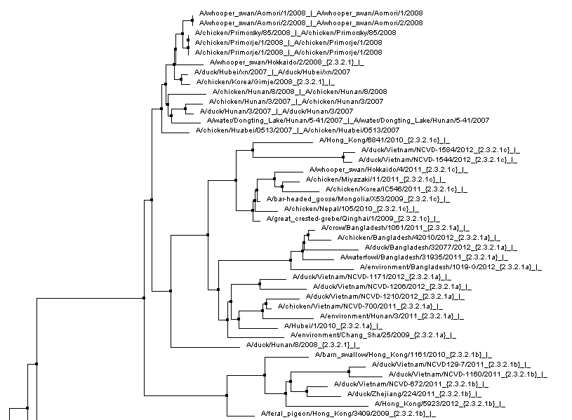
Identify the belonging clade of the studied samples
The Russian sample belong to clade 2.3.2.1

Slide 35


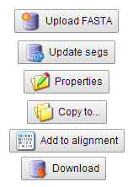
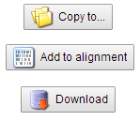

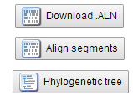
Summary of the activities
Set the research parameters, select sequnces
Create or open your worksets
Upload a fasta file
Complete the informative fields
A workset
Set download format

Slide 36
Thank you for your attention
If you have any problem contact me at:
imonne@izsvenezie.it

